Slide 1
Energy
What is it?

Slide 2
http://www.youtube.com/watch?v=JmnRJ2M4eik

Slide 3
Energy
Energy is the capacity of a physical system to perform work.
Energy can neither be created or destroyed.
Energy exists in several forms such as heat, kinetic or mechanical energy, light, potential energy, electrical, or other forms.
Energy can be (is) stored or transferred from place to place, or object to object in different ways.

Slide 4
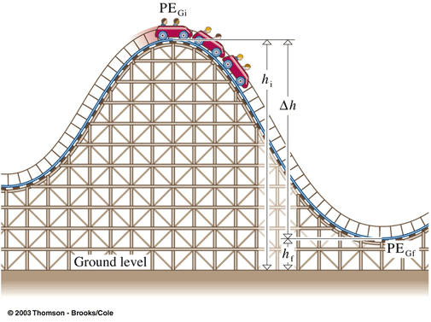
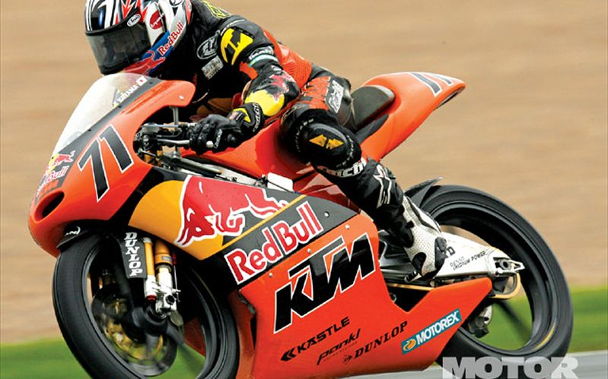
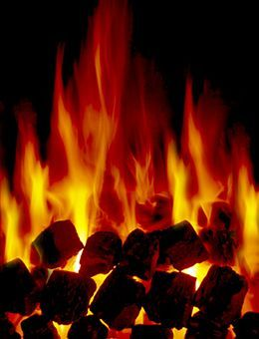
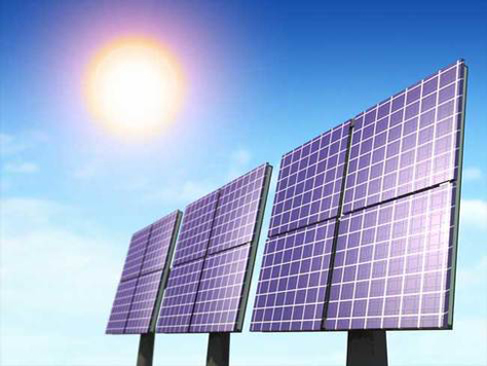
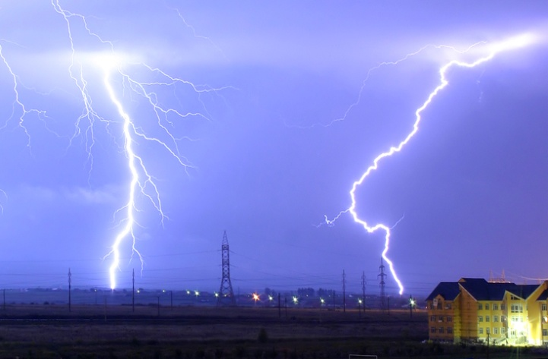
Forms of energy

Slide 5
Mechanical Energy
Mechanical energy is the most familiar form of energy. It is the energy a substance or system has because of its motion. Every moving object has mechanical energy, whether it is a hammer driving a nail, a leaf falling from a tree, or a rocket flying in space. Mechanical energy pulls, pushes, twists, turns and throws.
Machines use mechanical energy to do work. Our bodies also use mechanical energy to perform motions such as throwing a ball or moving a pencil to write on paper.

Slide 6
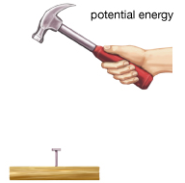
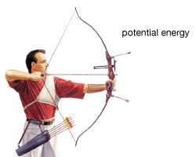
Two Types of Mechanical Energy
The two types of mechanical energy are potential and kinetic.
Potential - An object can store energy as the result of its position. Energy of position.
Gravitational potential energy is the energy stored in an object as the result of its vertical position or height. The energy is stored as the result of the gravitational attraction of the Earth for the object.
Potential energy has an equation:
E = mgh E = energy
m = mass
g = gravity
h = height

Slide 7
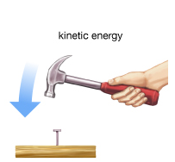
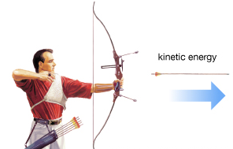
Kinetic energy is the energy of motion. An object that has motion - whether it is vertical or horizontal motion - has kinetic energy.
The equation for kinetic energy is:
E = ½ mv²
E = energy
m = mass
v = velocity

Slide 8
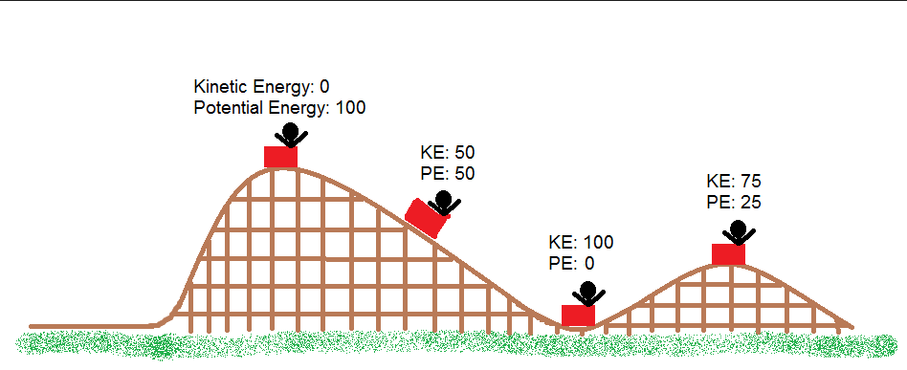
An object may have both kinetic and potential energy at the same time. The sum of PE and KE is constant all the way through. (ideally)

Slide 9
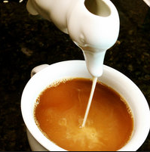
Thermal energy
Thermal energy is what we call energy that comes from heat.
For example, a cup of hot coffee has thermal energy in the form of kinetic energy from its' particles. When you pour some cream into your coffee, some of this energy is transferred to the particles in cold cream. Therefore the cup of coffee is cooler because it lost thermal energy to the cream.

Slide 10
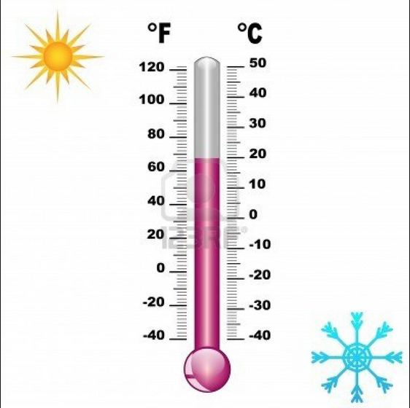
Temperature
Temperature is the degree or intensity of heat present in a substance or object, as expressed according to a comparative scale and shown by a thermometer or perceived by touch.

Slide 11
Heat Energy
Heat energy (or just heat) is a form of energy which transfers among particles in a substance (or system) by means of kinetic energy of those particles. In other words, under kinetic theory, the heat is transferred by particles bouncing into each other.

Slide 12
Difference between heat and temperature
A swimming pool at 30°C is at a lower temperature than a cup of tea at 80°C. But the swimming pool contains more water, so it stores more thermal energy than the cup of tea.
To boil water we must increase its temperature to 100°C. It takes longer to boil a large beaker of water than a small beaker because the large beaker contains more water and needs more thermal energy to reach 100°C.

Slide 13
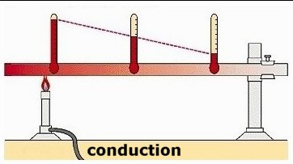
Transfer of heat energy
The 3 ways that heat is transferred:
Conduction - Heat conduction (as opposed to electrical conduction) is the flow of internal energy from a region of higher temperature to one of lower temperature by the interaction of the adjacent particles (atoms, molecules, ions, electrons, etc.) in the intervening space.
http://www.eschooltoday.com/energy/kinds-of-energy/heat-transfer-by-conduction.html

Slide 14
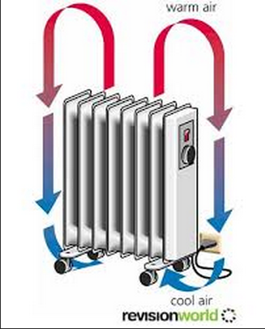
Transfer of heat energy
2. Convection - the movement caused within a fluid by the tendency of hotter and therefore less dense material to rise, and colder, denser material to sink under the influence of gravity, which consequently results in transfer of heat.

Slide 15
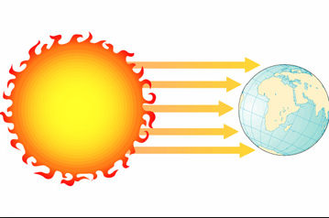
Transfer of heat energy
Radiation is a method of heat transfer that does not rely upon any contact between the heat source and the heated object as is the case with conduction and convection.

Slide 16
Summary of heat energy transfer

Slide 17
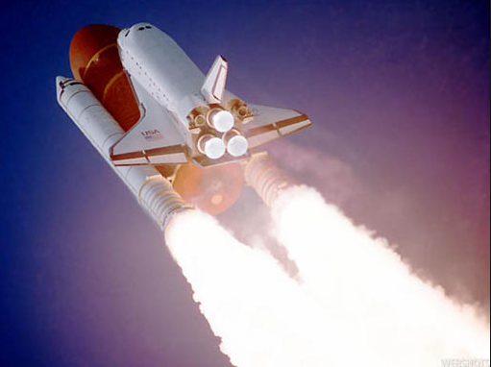
Chemical Energy
Chemical Energy is energy stored in the bonds of chemical compounds (atoms and molecules). It is released in a chemical reaction, often producing heat as a byproduct (exothermic reaction). Batteries, biomass, petroleum, natural gas, and coal are examples of stored chemical energy. Usually, once chemical energy is released from a substance, that substance is transformed into an entirely new substance.

Slide 18
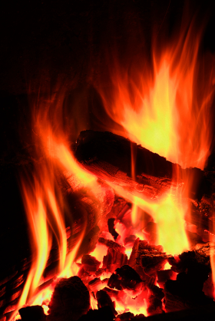
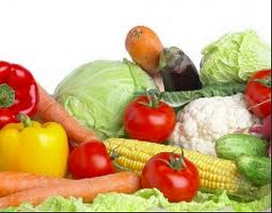
The dry wood is a store of chemical energy. As it burns in the fireplace, chemical energy is released and converted to thermal energy (heat) and light energy. Notice that the wood now turns into ashes (a new substance)
Food is also a good example of stored chemical energy. This energy is released during digestion. Molecules in our food are broken down into smaller pieces. As the bonds between these atoms loosen or break, a chemical reaction will occur, and new compounds are created. When the bonds break or loosen, oxidation occurs almost instantly.

Slide 19
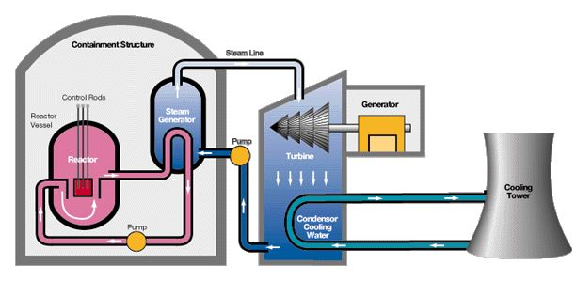
Nuclear Energy
Nuclear energy is energy that is stored in the nucleus or center core of an atom. The nucleus of an atom is made of tiny particles of protons (+ positive charge) and neutrons (no charge). The electrons(- negative charge) move around the nucleus. The nuclear energy is what holds the nucleus together.

Slide 20
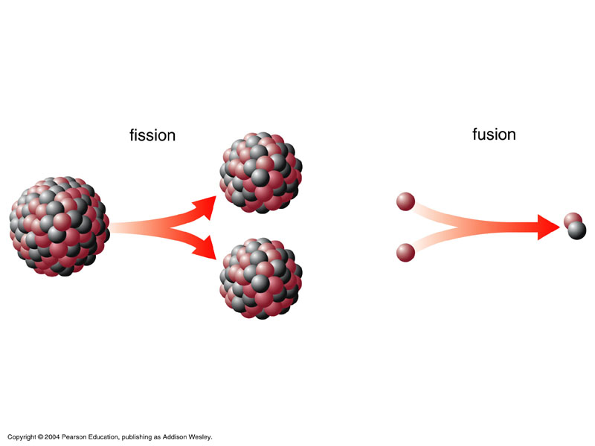
Nuclear Energy
In order to use this energy, it has to be released from the atom. There are two ways to free the energy inside the atom.
Fusion and Fission

Slide 21
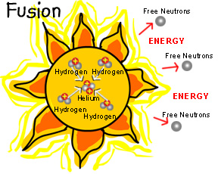
Fusion is a way of combining the atoms to make a new atom.
For example, the energy from the sun is produced by fusion. Inside the sun, hydrogen atoms are combined to make helium. Helium doesn't need that much energy to hold it together, so the extra energy produced is released as heat and light.

Slide 22
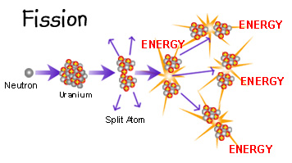
Fission is a way of splitting an atom into two smaller atoms. The two smaller atoms don't need as much energy to hold them together as the larger atom, so the extra energy is released as heat and radiation.
Nuclear power plants use fission to make electricity. By splitting uranium atoms into two smaller atoms, the extra energy is released as heat. Uranium is a mineral rock, a very dense metal, that is found in the ground and is non-renewable, that means we can't make more. It is a cheap and plentiful fuel source. Power plants use the heat given off during fission as fuel to make electricity.

Slide 23
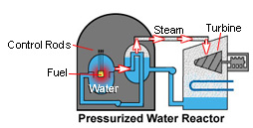
Fission creates heat which is used to boil water into steam inside a reactor. The steam then turns huge turbines that drive generators that make electricity. The steam is then changed back into water and cooled down in a cooling tower. The water can then be used over and over again.

Slide 24
Electrical Energy
Electrical energy is the movement of charged particles, negative (-) and positive (+). It can come from batteries or power plants and it can also be found in nature.
In order for electricity to flow, it must follow a complete path through a circuit. A circuit starts at the source of the electricity and ends at an output device where the electricity is used or released. A switch controls the current as it flows through the circuit. For example, a circuit can start at a battery (source) and flow through a copper wire and a switch until it reaches a light bulb (output device) and back again to the battery.
The electricity that flows through a circuit is current electricity. It can only flow through closed circuits, meaning there are no gaps or breaks in the path. A broken path is called an open circuit.
Electrical current is measured in units called amperes. It is measured in amps.

Slide 25
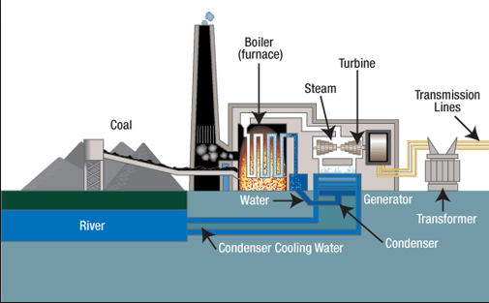
The electrical current that flows to your home is known as alternating current (AC) because it moves back and forth. AC is produced by a generator at a power plant as it changes mechanical energy to electrical energy. Generators use turbines to spin a coil around a magnet. Most turbines are turned by steam that comes from burning fossil fuels (coal, oil, natural gas). The rising steam turns the blades of the turbine. Wind or water controlled by dams can also be used to power the generator’s turbine.

Slide 26
Light Energy
Light energy is a form of energy which our sense of sight can detect.
Light energy is made of electro-magnetic radiation and travels in a straight path.
Light energy has the ability to tan or burn our skins, it can be harnessed to melt metals, or heat our food.
Light energy is always in motion and cannot be stored, so it is a kinetic type of energy.
Light is simultaneously a wave and a particle.
The particle in light energy is called photon.
Light energy is energy that travels in straight lines called rays that fan outward from the source of the light.

Slide 27
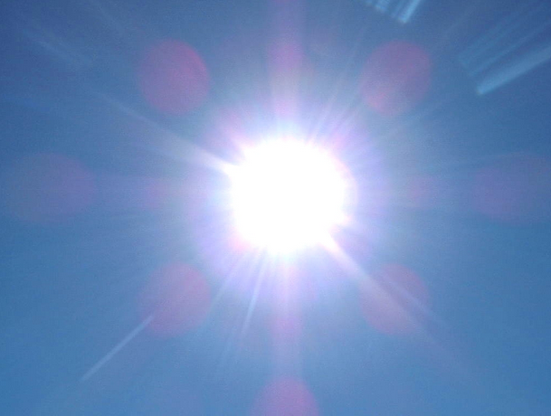
Light Energy
The quantum theory suggests that light consists of very small bundles of energy/particles; it's just that simple. Scientists call those small particles photons, and the wavelength determines the energy and type of EM radiation, and the number of photons tells you how much radiation there is. A lot of photons give a brighter, more intense type of light. Fewer photons give a very dim and less intense light. When you use the dimmer switch on the wall, you are decreasing the number of photons sent from the light bulb. The type of light is the same while the amount has changed.

Slide 28
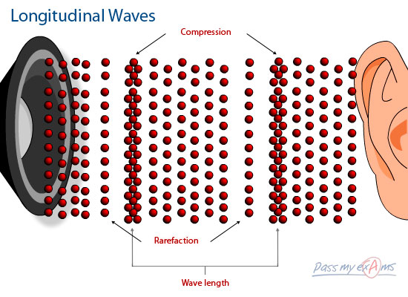
Sound Energy
Sound is the movement of energy through substances in longitudinal (compression/rarefaction) waves. Sound is produced when a force causes an object or substance to vibrate — the energy is transferred through the substance in a wave. Typically, the energy in sound is far less than other forms of energy.
Sound vibrations create sound waves which move through mediums such as air and water before reaching our ears.
Since sound energy is motion, it is kinetic.

Slide 29
Since we defined energy as work performed, we need to understand what work is.
Work is done when a net force acts on an object and the object moves in the direction of the net force.
Work is the product of the force on an object and the distance through which the object is moved.
Work = force x distance = Fd

Slide 30
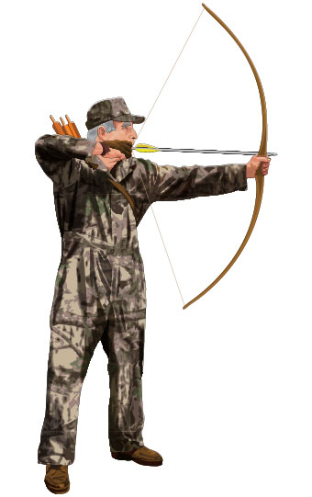
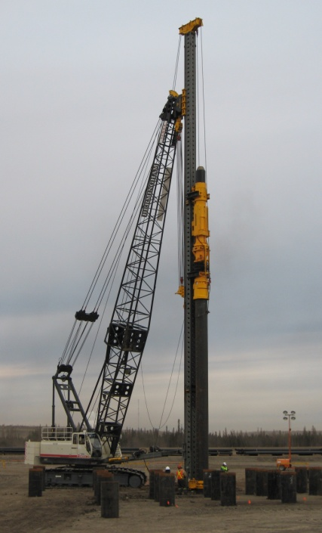
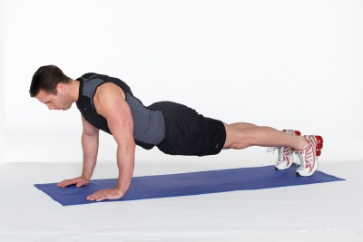
Examples of work
An archer stretches his bowstring, doing work against the elastic forces of the bow.
When the ram of a pile driver is raised, work is required to raise the ram against the force of gravity.
When you do push-ups, you do work against your own weight.

Slide 31
Unit of work
The unit of measurement for work combines a unit of force, N, with a unit of distance, m.
The unit of work is the newton-meter (N•m), also called the joule.
One joule (J) of work is done when a force of 1 N is exerted over a distance of 1 m (lifting an apple over your head).

Slide 32
Example
Suppose that you apply a 60-N horizontal force to a 32-kg package, which pushes it 4 meters across a mailroom floor. How much work do you do on the package?

Slide 33
Power
When we talk about work, we also need to consider power as well.
Power equals the amount of work done divided by the time interval during which the work is done.
Power is the rate at which work is done.
P = Work / time

Slide 34
Power
A high-power engine does work rapidly.
An engine that delivers twice the power of another engine does not necessarily produce twice as much work or go twice as fast.
Twice the power means the engine can do twice the work in the same amount of time or the same amount of work in half the time.
A powerful engine can get an automobile up to a given speed in less time than a less powerful engine can.

Slide 35
Unit of Power
The unit of power is the joule per second, also known as the watt.
One watt (W) of power is expended when one joule of work is done in one second.
One kilowatt (kW) equals 1000 watts.
One megawatt (MW) equals one million watts.
In the United States, we customarily rate engines in units of horsepower and electricity in kilowatts, but either may be used.
In the metric system of units, automobiles are rated in kilowatts. One horsepower (hp) is the same as 0.75 kW, so an engine rated at 134 hp is a 100-kW engine.

Slide 36
Potential Energy in depth
Three examples of potential energy are elastic potential energy, chemical energy, and gravitational potential energy.

Slide 37
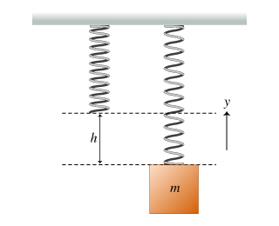
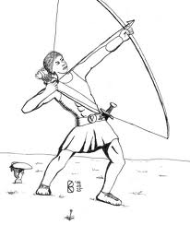
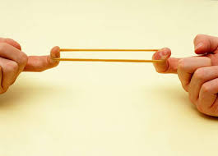
Elastic Potential Energy
A stretched or compressed spring has a potential for doing work.
When a bow is drawn back, energy is stored in the bow. The bow can do work on the arrow.
A stretched rubber band has potential energy because of its position.
These types of potential energy are elastic potential energy.

Slide 38
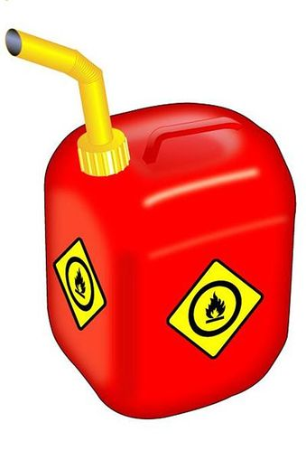
Chemical Potential Energy
The chemical energy in fuels is also potential energy.
It is energy of position at the submicroscopic level. This energy is available when the positions of electric charges within and between molecules are altered and a chemical change takes place.

Slide 39
Gravitational Potential Energy
Work is required to elevate objects against Earth’s gravity.
The potential energy due to elevated positions is gravitational potential energy.
Water in an elevated reservoir and the raised ram of a pile driver have gravitational potential energy.

Slide 40
The amount of gravitational potential energy possessed by an elevated object is equal to the work done against gravity to lift it.
The upward force required while moving at constant velocity is equal to the weight, mg, of the object, so the work done in lifting it through a height h is the product mgh.
gravitational potential energy = weight × height
PE = mgh

Slide 41
Potential Energy
The potential energy of the 100-N boulder with respect to the ground below is 200 J in each case.
The boulder is lifted with 100 N of force.

Slide 42
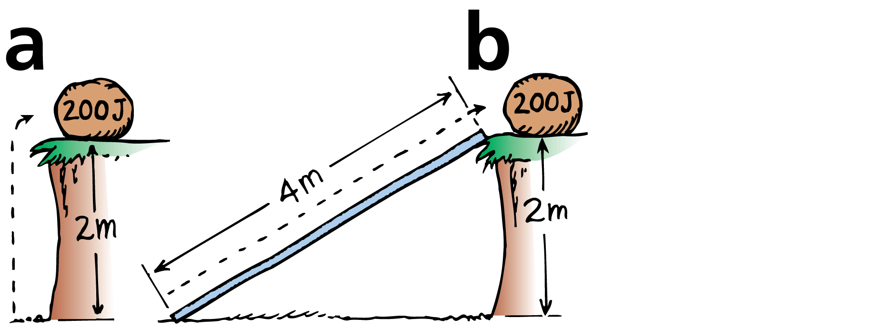
Potential Energy
The potential energy of the 100-N boulder with respect to the ground below is 200 J in each case.
The boulder is lifted with 100 N of force.
The boulder is pushed up the 4-m incline with 50 N of force.

Slide 43
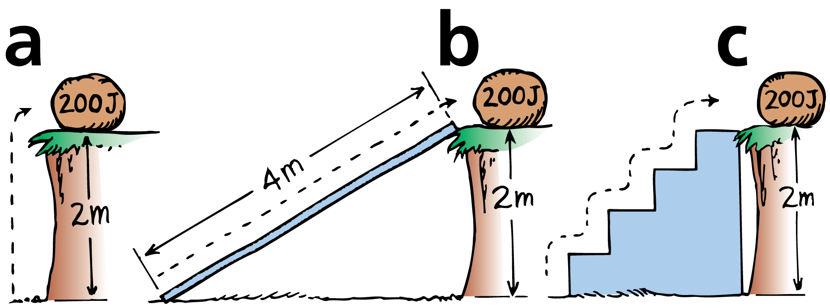
Potential Energy
The potential energy of the 100-N boulder with respect to the ground below is 200 J in each case.
The boulder is lifted with 100 N of force.
The boulder is pushed up the 4-m incline with 50 N of force.
The boulder is lifted with 100 N of force up each 0.5-m stair.

Slide 44
Kinetic energy in depth
The kinetic energy of a moving object is equal to the work required to bring it to its speed from rest, or the work the object can do while being brought to rest.

Slide 45
Kinetic energy
If an object is moving, then it is capable of doing work. It has energy of motion, or kinetic energy (KE).
The kinetic energy of an object depends on the mass of the object as well as its speed.
It is equal to half the mass multiplied by the square of the speed.

Slide 46
When you throw a ball, you do work on it to give it speed as it leaves your hand. The moving ball can then hit something and push it, doing work on what it hits.
Note that the speed is squared, so if the speed of an object is doubled, its kinetic energy is quadrupled (2² = 4).
It takes four times the work to double the speed.
An object moving twice as fast takes four times as much work to stop.

Slide 47
Work-Energy Theorem
The work-energy theorem states that whenever work is done, energy changes.

Slide 48
To increase the kinetic energy of an object, work must be done on the object.
If an object is moving, work is required to bring it to rest.
The change in kinetic energy is equal to the net work done.
The work-energy theorem describes the relationship between work and energy.

Slide 49
We abbreviate “change in” with the delta symbol, ∆
Work = ∆KE
Work equals the change in kinetic energy.
The work in this equation is the net work—that is, the work based on the net force.

Slide 50
If there is no change in an object’s kinetic energy, then no net work was done on it.
Push against a box on a floor.
If it doesn’t slide, then you are not doing work on the box.
On a very slippery floor, if there is no friction at all, the work of your push times the distance of your push appears as kinetic energy of the box.

Slide 51
If there is some friction, it is the net force of your push minus the frictional force that is multiplied by distance to give the gain in kinetic energy.
If the box moves at a constant speed, you are pushing just hard enough to overcome friction. The net force and net work are zero, and, according to the work-energy theorem, ∆KE = 0. The kinetic energy doesn’t change.

Slide 52
The work-energy theorem applies to decreasing speed as well.
The more kinetic energy something has, the more work is required to stop it.
Twice as much kinetic energy means twice as much work.

Slide 53
When a car brakes, the work is the friction force supplied by the brakes multiplied by the distance over which the friction force acts.
A car moving at twice the speed of another has four times as much kinetic energy, and will require four times as much work to stop.
The frictional force is nearly the same for both cars, so the faster one takes four times as much distance to stop.
Kinetic energy depends on speed squared

Slide 54
Work-Energy Theorem
Typical stopping distances for cars equipped with antilock brakes traveling at various speeds. The work done to stop the car is friction force × distance of slide.

Slide 55
Work-Energy Theorem
Typical stopping distances for cars equipped with antilock brakes traveling at various speeds. The work done to stop the car is friction force × distance of slide.

Slide 56
Work-Energy Theorem
Typical stopping distances for cars equipped with antilock brakes traveling at various speeds. The work done to stop the car is friction force × distance of slide.

Slide 57
Kinetic energy often appears hidden in different forms of energy, such as heat, sound, light, and electricity.
Random molecular motion is sensed as heat.
Sound consists of molecules vibrating in rhythmic patterns.
Light energy originates in the motion of electrons within atoms.
Electrons in motion make electric currents.

Slide 58
A friend says that if you do 100 J of work on a moving cart, the cart will gain 100 J of KE. Another friend says this depends on whether or not there is friction. What is your opinion of these statements?
Although you do 100 J of work on the cart, this may not mean the cart gains 100 J of KE. How much KE the cart gains depends on the net work done on it.

Slide 59
When the brakes of a car are locked, the car skids to a stop. How much farther will the car skid if it’s moving 3 times as fast?

Slide 60
Work-Energy Theorem
When the brakes of a car are locked, the car skids to a stop. How much farther will the car skid if it’s moving 3 times as fast?
Answer:
Nine times farther. The car has nine times as much kinetic energy when it travels three times as fast:

Slide 61
The Law of Conservation of Energy
The law of conservation of energy states that energy cannot be created or destroyed. It can be transformed from one form into another, but the total amount of energy never changes.

Slide 62
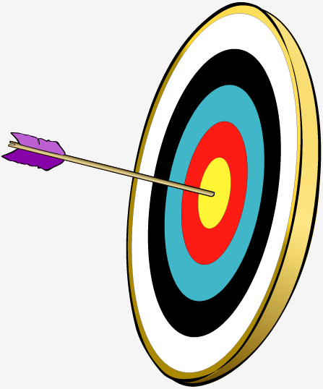
Potential energy will become the kinetic energy of the arrow.
As you draw back the arrow in a bow, you do work stretching the bow.
The bow then has potential energy.
When released, the arrow has kinetic energy equal to this potential energy.
It delivers this energy to its target.

Slide 63
The small distance the arrow moves multiplied by the average force of impact doesn’t quite match the kinetic energy of the target.
However, the arrow and target are a bit warmer by the energy difference.
Energy changes from one form to another without a net loss or a net gain.

Slide 64
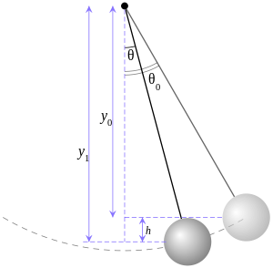
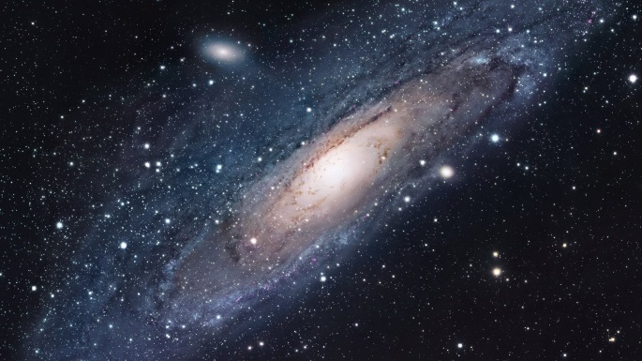
The study of the forms of energy and the transformations from one form into another is the law of conservation of energy.
For any system in its entirety—as simple as a swinging pendulum or as complex as an exploding galaxy—there is one quantity that does not change: energy.
Energy may change form, but the total energy stays the same.

Slide 65
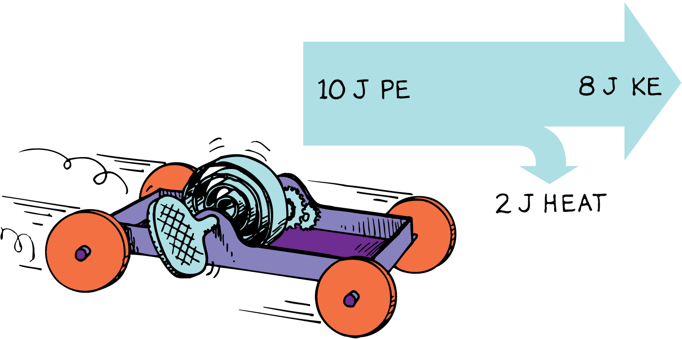
Conservation of Energy
Part of the PE of the wound spring changes into KE. The remaining PE goes into heating the machinery and the surroundings due to friction. No energy is lost.

Slide 66
Conservation of Energy
Everywhere along the path of the pendulum bob, the sum of PE and KE is the same. Because of the work done against friction, this energy will eventually be transformed into heat.

Slide 67
Conservation of Energy
When the woman leaps from the burning building, the sum of her PE and KE remains constant at each successive position all the way down to the ground.

Slide 68
Each atom that makes up matter is a concentrated bundle of energy.
When the nuclei of atoms rearrange themselves, enormous amounts of energy can be released.
The sun shines because some of its nuclear energy is transformed into radiant energy.
In nuclear reactors, nuclear energy is transformed into heat.

Slide 69
Enormous compression due to gravity in the deep, hot interior of the sun causes hydrogen nuclei to fuse and become helium nuclei.
This high-temperature welding of atomic nuclei is called thermonuclear fusion.
This process releases radiant energy, some of which reaches Earth.
Part of this energy falls on plants, and some of the plants later become coal.

Slide 70
Another part supports life in the food chain that begins with microscopic marine animals and plants, and later gets stored in oil.
Part of the sun’s energy is used to evaporate water from the ocean.
Some water returns to Earth as rain that is trapped behind a dam.

Slide 71
The water behind a dam has potential energy that is used to power a generating plant below the dam.
The generating plant transforms the energy of falling water into electrical energy.
Electrical energy travels through wires to homes where it is used for lighting, heating, cooking, and operating electric toothbrushes.

Slide 72
Machines
A machine transfers energy from one place to another or transforms it from one form to another.
A machine is a device used to multiply forces or simply to change the direction of forces.
The concept that underlies every machine is the conservation of energy. A machine cannot put out more energy than is put into it.

Slide 73
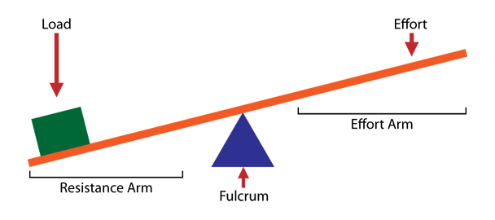
Simple machines
1. Lever - A lever is a stiff bar that rests on a support called a fulcrum which lifts or moves loads.

Slide 74
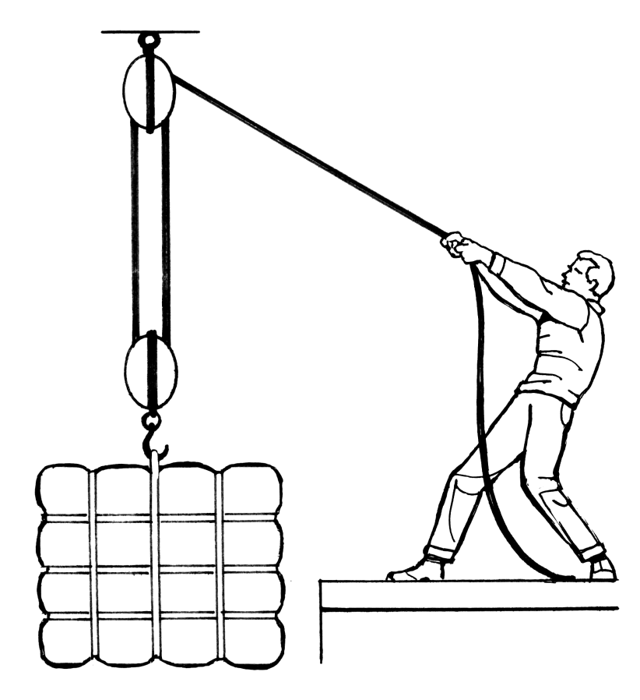
Simple machines
2. Pulley - A pulley is a simple machine that uses grooved wheels and a rope to raise, lower or move a load.
EFFORT
LOAD

Slide 75
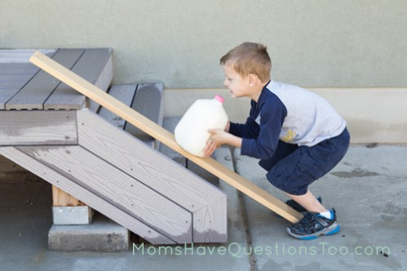
Simple machines
3. Incline plane - An inclined plane is a slanting surface connecting a lower level to a higher level.
EFFORT
LOAD

Slide 76
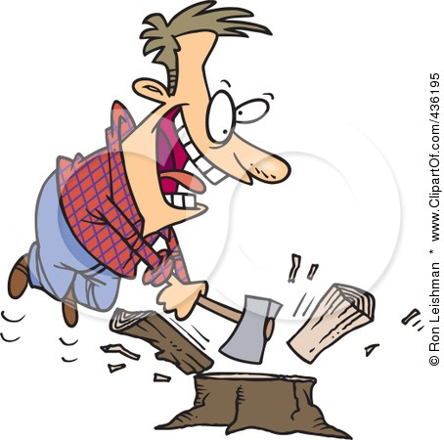
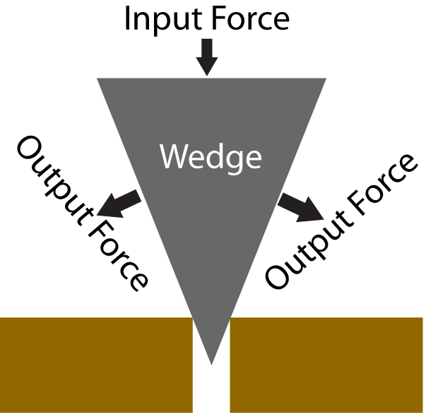
Simple machines
4. Wedge - A wedge is an object with at least one slanting side ending in a sharp edge, which cuts material apart.

Slide 77
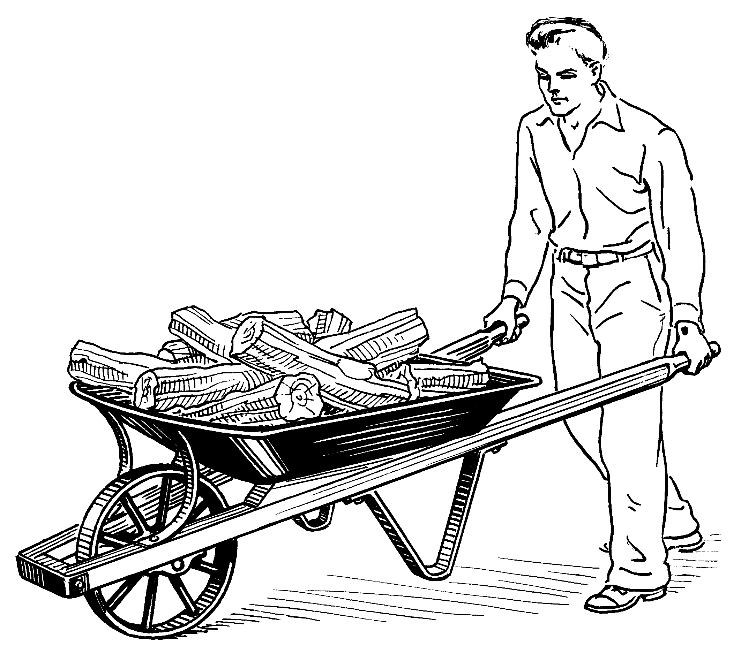
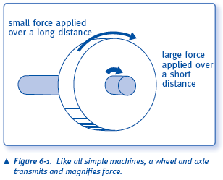
Simple machines
5. Wheel and Axle - A wheel with a rod, called an axle, through its center lifts or moves loads.

Slide 78
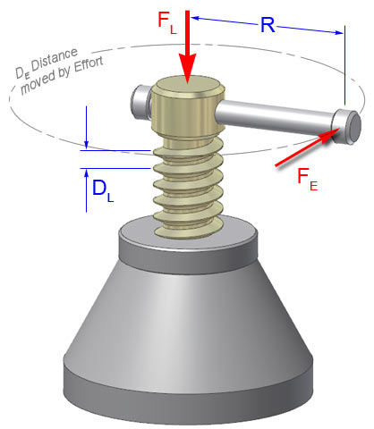
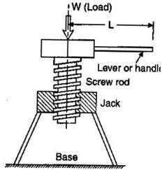
Simple machines
6. Screw - A screw is an inclined plane wrapped around a pole which holds things together or lifts materials

Slide 79
http://www.cosi.org/downloads/activities/simplemachines/sm1.html

Slide 80
Lever
The pivot point, or fulcrum, of the lever can be relatively close to the load.
Then a small input force exerted through a large distance will produce a large output force over a short distance.
In this way, a lever can multiply forces.
However, no machine can multiply work or energy

Slide 81
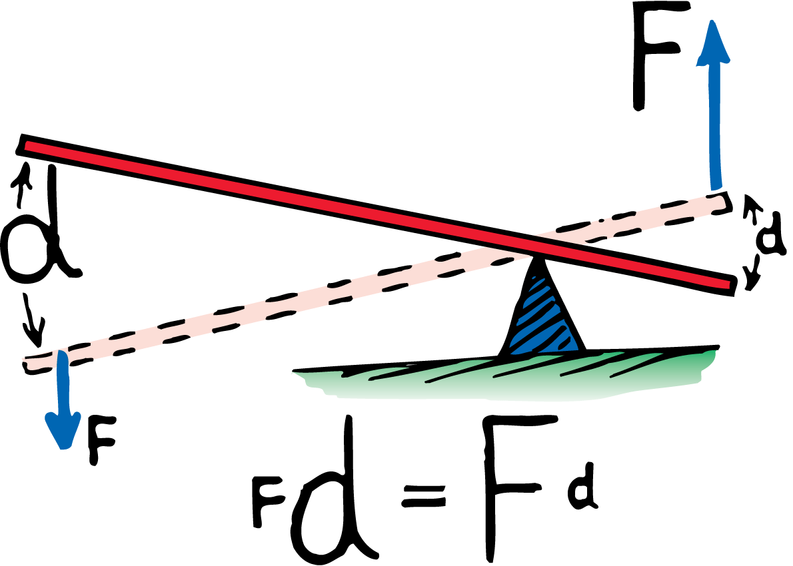
Lever
In the lever, the work (force × distance) done at one end is equal to the work done on the load at the other end.

Slide 82
Lever
The output force is eight times the input force.
The output distance is one eighth of the input distance.

Slide 83
The child pushes down 10 N and lifts an 80-N load.
The ratio of output force to input force for a machine is called the mechanical advantage.
The mechanical advantage is (80 N)/(10 N), or 8.

Slide 84
There are three common ways to set up a lever:
A type 1 lever has the fulcrum between the force and the load, or between input and output.
A type 2 lever has the load between the fulcrum and the input force.
A type 3 lever has the fulcrum at one end and the load at the other.

Slide 85
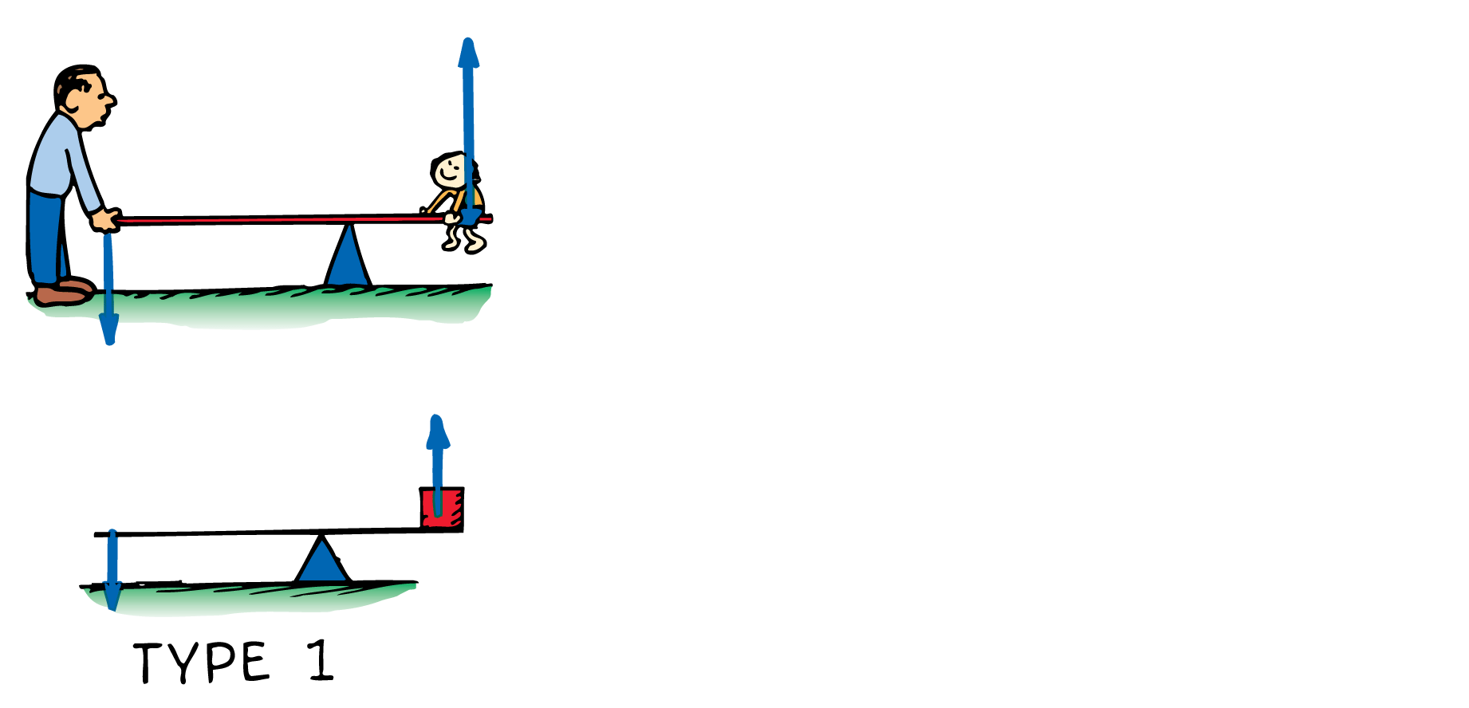
Lever
The three basic types of levers are shown here.

Slide 86
Lever
The three basic types of levers are shown here.

Slide 87
Lever
The three basic types of levers are shown here.

Slide 88
For a type 1 lever, push down on one end and you lift a load at the other. The directions of input and output are opposite.
For a type 2 lever, you lift the end of the lever. Since the input and output forces are on the same side of the fulcrum, the forces have the same direction.
For a type 3 lever, the input force is applied between the fulcrum and the load. The input and output forces are on the same side of the fulcrum and have the same direction.

Slide 89
Pulleys
A pulley can change the direction of a force.

Slide 90
Pulleys
A pulley can change the direction of a force.
A pulley multiplies force.

Slide 91
Pulleys
A pulley can change the direction of a force.
A pulley multiplies force.
Two pulleys can change the direction and multiply force.

Slide 92
Pulleys
This single pulley behaves like a type 1 lever.
The axis of the pulley acts as the fulcrum.
Both lever distances (the radius of the pulley) are equal so the pulley does not multiply force.
It changes the direction of the applied force.
The mechanical advantage equals 1.

Slide 93
Pulleys
This single pulley acts as a type 2 lever.
The fulcrum is at the left end of the “lever” where the supporting rope makes contact with the pulley.
The load is halfway between the fulcrum and the input.
1 N of input will support a 2-N load, so the mechanical advantage is 2.
The load is now supported by two strands of rope, each supporting half the load.

Slide 94
Pulleys
The mechanical advantage for simple pulley systems is the same as the number of strands of rope that actually support the load.
The mechanical advantage of this simple system is 2.
Although three strands of rope are shown, only two strands actually support the load.
The upper pulley serves only to change the direction of the force.

Slide 95
Pulleys
When the rope is pulled 5 m with a force of 100 N, a 500-N load is lifted 1 m.
The mechanical advantage is (500 N)/(100 N), or 5.
Force is multiplied at the expense of distance.

Slide 96
Thermal Energy
What is thermal energy?
Thermal energy is the energy that comes from heat. This heat is generated by the movement of tiny particles within an object. The faster these particles move, the more heat is generated. Stoves and matches are examples of objects that conduct thermal energy.

Slide 97
How does Thermal Energy relate to temperature?
How does Thermal Energy relate to Kinetic Energy?
As thermal energy is added, the particles move quicker and there is an increase in kinetic energy which results in an increase in temperature.

Slide 98
Conversions
Temperature –

Slide 99
How does Thermal Energy relate to Chemical Energy?
Sometimes the release of chemical energy is in the form of thermal energy (heat).

Slide 100
The three methods of transfer for thermal energy is:
Conduction occurs when thermal energy is transferred through the interaction of solid particles. This process often occurs when cooking: the boiling of water in a metal pan causes the metal pan to warm as well.
Convection usually takes place in gases or liquids (whereas conduction most often takes place in solids) in which the transfer of thermal energy is based on differences in heat. Using the example of the boiling pot of water, convection occurs as the bubbles rise to the surface and, in doing so, transfer heat from the bottom to the top.
Radiation is the transfer of thermal energy through space and is responsible for the sunlight that fuels the earth.

Slide 101
What happens when thermal energy is transferred?
There is a temperature change (positive/negative). A change in temperature “equilibrium”.
Phase change

Slide 102
Phase change diagram

Slide 103
Temperature increase or decrease on the “slopes”.
The temperature stays the same on the plateaus. Phase change
Increase in heat from left to right (warmer)
Decrease in heat from right to left (colder)

Slide 104
Calculation of heat transfer
Temperature change:
Q = m C_{p} ΔT
heat transfer =
mass x (specific heat) x change in temperature
Phase change:
Q = m L
mass x Latent heat

Slide 105
Wave
A disturbance that is transmitted progressively from one place to the next with no actual transport of matter is a wave

Slide 106
Types of mechanical waves
Longitudinal Waves
In a longitudinal wave the particle displacement is parallel to the direction of wave propagation.
Transverse Waves
In a transverse wave the particle displacement is perpendicular to the direction of wave propagation

Slide 107
Wave Description
The Parts of a Wave
A weight attached to a spring undergoes simple harmonic motion.
A marking pen attached to the bob traces a sine curve on a sheet of paper that is moving horizontally at constant speed.
A sine curve is a pictorial representation of a wave.

Slide 108
A

Slide 109
The wavelength of a wave is the distance from the top of one crest to the top of the next one.
Equivalently, the wavelength is the distance between successive identical parts of the wave.
The wavelengths of waves at the beach are measured in meters, the ripples in a pond in centimeters, of light in billionths of a meter.

Slide 110
The number of vibrations an object makes in a unit of time is an object’s frequency.
The frequency specifies the number of back-and-forth vibrations in a given time (usually one second).

Slide 111
A complete back-and-forth vibration is one cycle.
If a vibration occurs in one second, the frequency is one cycle per second; if two vibrations occur in one second, the frequency is two cycles per second.
The frequency of the vibrating source and the frequency of the wave it produces are the same.

Slide 112
The unit of frequency is called the hertz (Hz).
A frequency of one cycle per second is 1 hertz, two cycles per second is 2 hertz, and so on. Higher frequencies are measured in
kilohertz (kHz—thousands of hertz)
megahertz (MHz—millions of hertz)
gigahertz (GHz—billions of hertz)

Slide 113
Frequency and Period
If the frequency of a vibrating object is known, its period can be calculated, and vice versa.

Slide 114
Energy transfer by a wave
The energy transferred by a wave from a vibrating source to a receiver is carried by a disturbance in a medium.

Slide 115
Most information gets to us in some form of wave.
Sound is energy that travels to our ears in the form of a wave.
Light is energy that comes to our eyes in the form of a different kind of wave (an electromagnetic wave).
The signals that reach our radio and television sets also travel in the form of electromagnetic waves.

Slide 116
Energy transfer
When energy is transferred by a wave from a vibrating source to a distant receiver, no matter is transferred between the two points.
Think about the very simple wave produced when one end of a horizontally stretched string is shaken up and down.
Each part of the string moves up and down and the disturbance moves horizontally along the length of the string.
The disturbance moves, not parts of the string itself.

Slide 117
Examples of wave energy
Drop a stone in a quiet pond and you’ll produce a wave that moves out from the center in an expanding circle.
It is the disturbance that moves, not the water.

Slide 118
Sound wave
When someone speaks to you from across the room, the sound wave is a disturbance in the air that travels across the room.
The air molecules themselves do not move along.
The air, like the rope and the water in the previous examples, is the medium through which wave energy travels.
Energy is not transferred by matter moving from one place to another within the medium.

Slide 119
The Sears Tower in Chicago sways back and forth at a frequency of about 0.1 Hz. What is its period of vibration?

Slide 120
The Sears Tower in Chicago sways back and forth at a frequency of about 0.1 Hz. What is its period of vibration?

Slide 121
You can calculate the speed of a wave by multiplying the wavelength by the frequency.

Slide 122
Speed of waves
The speed of a wave depends on the medium through which the wave moves.
Whatever the medium, the speed, wavelength, and frequency of the wave are related.

Slide 123
If the wavelength is 1 meter, and one wavelength per second passes the pole, then the speed of the wave is 1 m/s.

Slide 124
If the wavelength is 1 meter, and one wavelength per second passes the pole, then the speed of the wave is 1 m/s.

Slide 125
If the wavelength is 3 meters and if two crests pass a stationary point each second, then 3 meters × 2 waves pass by in 1 second.

Slide 126
If the wavelength is 3 meters and if two crests pass a stationary point each second, then 3 meters × 2 waves pass by in 1 second.
The waves therefore move at 6 meters per second.

Slide 127
In air, the product of wavelength and frequency is the same for every frequency of sound.
That’s why you don’t hear the high notes in a chord before you hear the low notes. The sounds all reach you at the same time.
Long wavelengths have low frequencies, and short wavelengths have high frequencies.

Slide 128
Wave Speed
Wavelength and frequency vary inversely to produce the same wave speed for all sounds.

Slide 129
If a water wave vibrates up and down two times each second and the distance between wave crests is 1.5 m, what is the frequency of the wave? What is its wavelength? What is its speed?

Slide 130
The frequency of the wave is 2 Hz; its wavelength is 1.5 m; and its wave speed is

Slide 131
What is the wavelength of a 340-Hz sound wave when the speed of sound in air is 340 m/s?

Slide 132
The wavelength must be 1 m.
Then wave speed = (1 m) × (340 Hz) = 340 m/s.

Slide 133
Interference
Interference patterns occur when waves from different sources arrive at the same point—at the same time.

Slide 134
A material object will not share its space with another object, but more than one wave can exist at the same time in the same space.
If you drop two rocks in water, the waves produced by each can overlap and form an interference pattern.

Slide 135
Interference pattern
An interference pattern is a regular arrangement of places where wave effects are increased, decreased, or neutralized.

Slide 136
Two types of interference
In constructive interference, the crest of one wave overlaps the crest of another and their individual effects add together.
The result is a wave of increased amplitude, called reinforcement.

Slide 137
Two types of interference
In destructive interference, the crest of one wave overlaps the trough of another and their individual effects are reduced.
The high part of one wave fills in the low part of another, called cancellation.

Slide 138
a. In constructive interference, the waves reinforce each other to produce a wave of increased amplitude.

Slide 139
b. In destructive interference, the waves cancel each other and no wave is produced.

Slide 140
Wave interference is easiest to see in water as an interference pattern.
When waves are out of phase, the crests of one wave overlap the troughs of another to produce regions of zero amplitude.
When waves are in phase, the crests of one wave overlap the crests of the other, and the troughs overlap as well.

Slide 141
Two overlapping water waves produce an interference pattern.
Overlapping concentric circles produce a pictorial representation of an interference pattern.

Slide 142
Standing wave
A standing wave forms only if half a wavelength or a multiple of half a wavelength fits exactly into the length of the vibrating medium

Slide 143
Produce a wave by tying a rope to a wall and shaking the free end up and down. The wave reflects back along the rope to you.
By shaking the rope just right, you can cause the incident (original) and reflected waves to form a standing wave.
A standing wave is a wave that appears to stay in one place—it does not seem to move through the medium.
http://www.youtube.com/watch?v=-gr7KmTOrx0

Slide 144
Certain parts of a standing wave remain stationary.
Nodes are the stationary points on a standing wave. Hold your fingers on either side of the rope at a node, and the rope will not touch them.
The positions on a standing wave with the largest amplitudes are known as antinodes.
Antinodes occur halfway between nodes.

Slide 145
Standing waves are the result of interference.
When two waves of equal amplitude and wavelength pass through each other in opposite directions, the waves are always out of phase at the nodes.
The nodes are stable regions of destructive interference

Slide 146
The incident and reflected waves interfere to produce a standing wave. The nodes are places that remain stationary.

Slide 147
You can produce a variety of standing waves by shaking the rope at different frequencies.
Once you find a frequency that produces a standing wave, double or triple frequencies will also produce a standing wave.

Slide 148
Shake the rope until you set up a standing wave of ½ wavelength.

Slide 149
Shake the rope until you set up a standing wave of ½ wavelength.
Shake with twice the frequency and produce a standing wave of 1 wavelength.

Slide 150
Shake the rope until you set up a standing wave of ½ wavelength.
Shake with twice the frequency and produce a standing wave of 1 wavelength.
Shake with three times the frequency and produce a standing wave of 1 ½ wavelengths.

Slide 151
Standing waves are set up in the strings of musical instruments that are struck.
Standing waves can be produced in either transverse or longitudinal waves.

Slide 152
The Doppler Effect
As a wave source approaches, an observer encounters waves with a higher frequency. As the wave source moves away, an observer encounters waves with a lower frequency.

Slide 153
Imagine a bug jiggling its legs and bobbing up and down in the middle of a quiet puddle.
The crests of the wave it makes are concentric circles, because the wave speed is the same in all directions.
If the bug bobs in the water at a constant frequency, the wavelength will be the same for all successive waves.
The wave frequency is the same as the bug’s bobbing frequency.

Slide 154
Suppose the jiggling bug moves across the water at a speed that is less than the wave speed.
The wave pattern is distorted and is no longer concentric.
The center of the outer crest is made when the bug is at the center of that circle.
The center of the next smaller crest was made when the bug was at the center of that circle, and so forth.

Slide 155
The Doppler Effect
The bug maintains the same bobbing frequency as before.
However, an observer would encounter a higher frequency if the bug is moving toward the observer.
This is because each successive crest has a shorter distance to travel so they arrive more frequently.

Slide 156
The Doppler Effect
Police use the Doppler effect of radar waves to measure the speeds of cars on the highway.
Radar waves are electromagnetic waves.
Police bounce them off moving cars. A computer built into the radar system compares the frequency of the radar with the frequency of the reflected waves to find the speed of the car.

Slide 157
Light
The Doppler effect also occurs for light.
When a light source approaches, there is an increase in its measured frequency.
When it recedes, there is a decrease in its frequency.

Slide 158
Light
Increasing frequency is called a blue shift, because the increase is toward the high-frequency, or blue, end of the spectrum.
Decreasing frequency is called a red shift, referring to the low-frequency, or red, end of the color spectrum.
Distant galaxies show a red shift in their light. A measurement of this shift enables astronomers to calculate their speeds of recession.

Slide 159
When a source moves toward you, do you measure an increase or decrease in wave speed?

Slide 160
When a source moves toward you, do you measure an increase or decrease in wave speed?
Answer:
Neither! It is the frequency of a wave that undergoes a change, not the wave speed.

Slide 161
Bow waves
A bow wave occurs when a wave source moves faster than the waves it produces.

Slide 162
When the speed of the source in a medium is as great as the speed of the waves it produces, something interesting happens. The waves pile up.
If the bug swims as fast as the wave speed, it will keep up with the wave crests it produces.
The bug moves right along with the leading edge of the waves it is producing.

Slide 163
The same thing happens when an aircraft travels at the speed of sound.
The overlapping wave crests disrupt the flow of air over the wings, so that it is harder to control the plane when it is flying close to the speed of sound.
http://www.youtube.com/watch?v=Kdm6gubnVkc

Slide 164
When the plane travels faster than sound, it is supersonic.
A supersonic airplane flies into smooth, undisturbed air because no sound wave can propagate out in front of it.

Slide 165
When the bug swims faster than wave speed, it outruns the wave crests it produces.
The crests overlap at the edges, and the pattern made by these overlapping crests is a V shape, called a bow wave.
The bow wave appears to be dragging behind the bug.
The familiar bow wave generated by a speedboat is produced by the overlapping of many circular wave crests.

Slide 166
v = speed of bug
v_{w}= wave speed
The wave patterns made by a bug swimming at successively greater speeds change. Overlapping at the edges occurs only when the source travels faster than wave speed.

Slide 167
A shock wave occurs when an object moves faster than the speed of sound.

Slide 168
A speedboat knifing through the water generates a two-dimensional bow wave.
A supersonic aircraft similarly generates a shock wave.
A shock wave is a three-dimensional wave that consists of overlapping spheres that form a cone.
The conical shock wave generated by a supersonic craft spreads until it reaches the ground.

Slide 169
The bow wave of a speedboat that passes by can splash and douse you if you are at the water’s edge.
In a sense, you can say that you are hit by a “water boom.”
In the same way, a conical shell of compressed air sweeps behind a supersonic aircraft.
The sharp crack heard when the shock wave that sweeps behind a supersonic aircraft reaches the listeners is called a sonic boom.

Slide 170
We don’t hear a sonic boom from a subsonic aircraft.
The sound wave crests reach our ears one at a time and are perceived as a continuous tone.
Only when the craft moves faster than sound do the crests overlap and encounter the listener in a single burst.
Ears cannot distinguish between the high pressure from an explosion and the pressure from many overlapping wave crests.

Slide 171
A common misconception is that sonic booms are produced only at the moment that the aircraft surpasses the speed of sound.
In fact, a shock wave and its resulting sonic boom are swept continuously behind an aircraft traveling faster than sound.
http://www.youtube.com/watch?v=gWGLAAYdbbc

Slide 172
The shock wave has not yet encountered listener C, but is now encountering listener B, and has already passed listener A.

Slide 173
A supersonic bullet passing overhead produces a crack, which is a small sonic boom.
When a lion tamer cracks a circus whip, the cracking sound is actually a sonic boom produced by the tip of the whip.
Snap a towel and the end can exceed the speed of sound and produce a mini sonic boom.
The bullet, whip, and towel are not in themselves sound sources. When they travel at supersonic speeds, sound is generated as waves of air at the sides of the moving objects.

